Slide 1
Programming Assignment 4 Report
Thomas Cousins
UIN: 927004846
CSCE 748

Slide 2
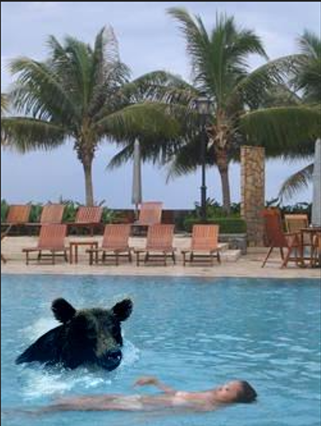
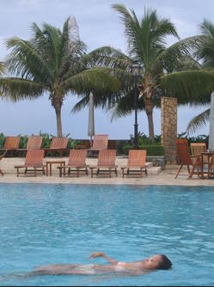
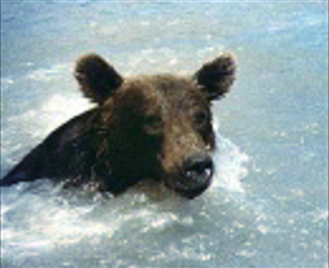
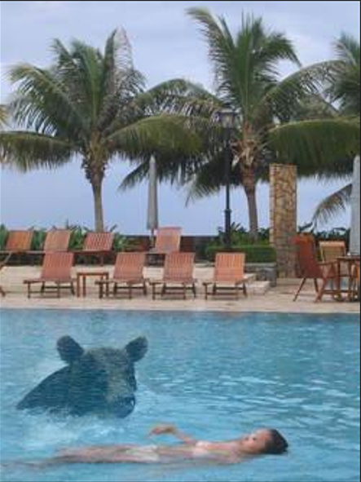
Test_01
Naïve (alpha=1)
Mixing (Alpha= .5)

Slide 3
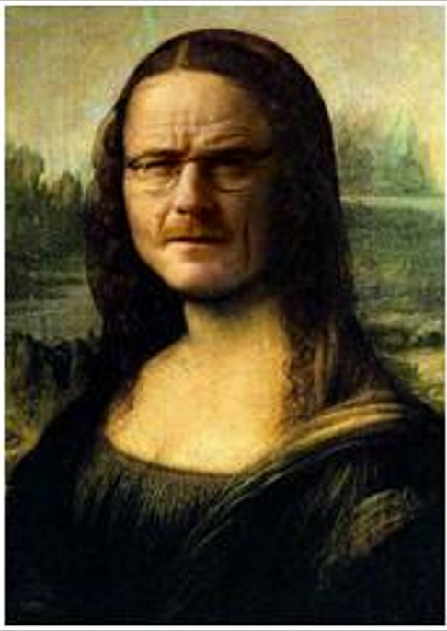
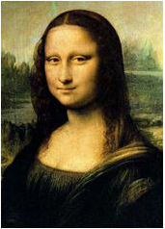
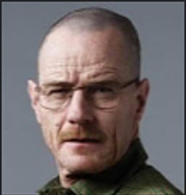
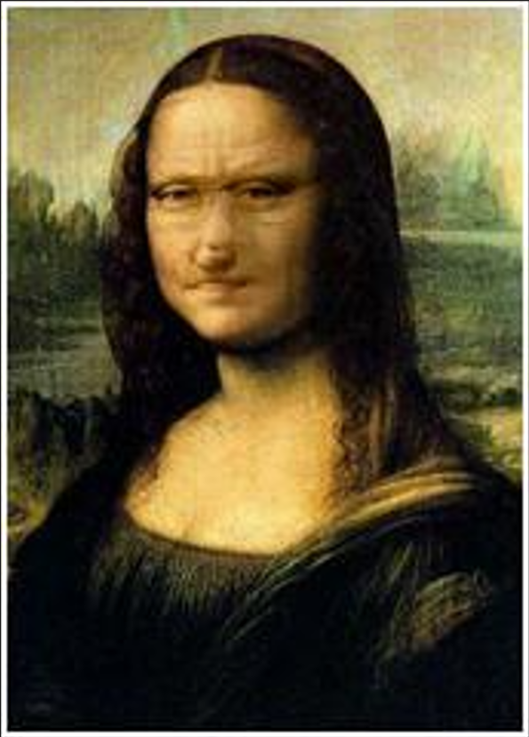
Test_02
Naïve (alpha=1)
Mixing (Alpha= .5)

Slide 4
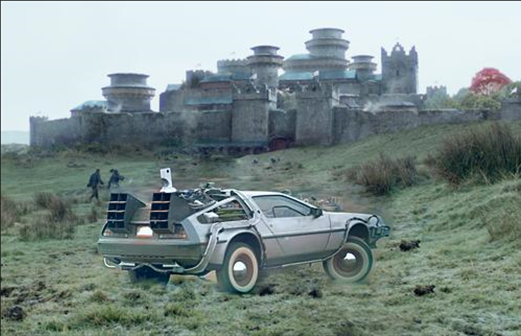
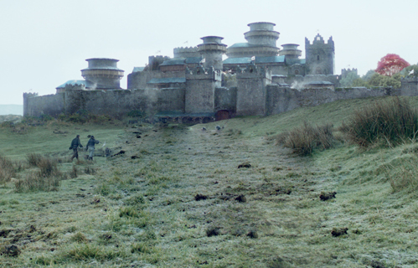
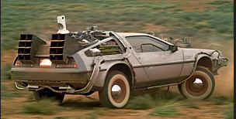
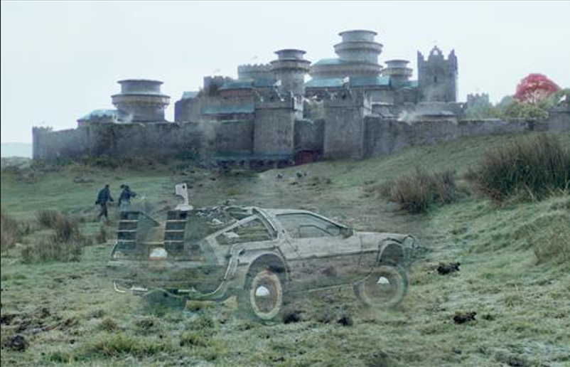
Test_03
Naïve (alpha=1)
Mixing (Alpha= .5)

Slide 5
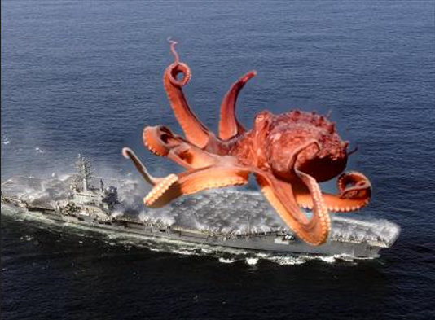
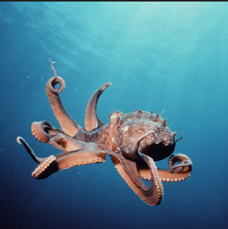
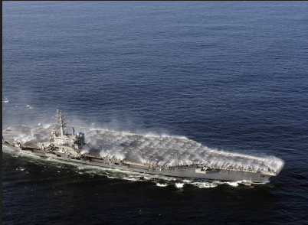
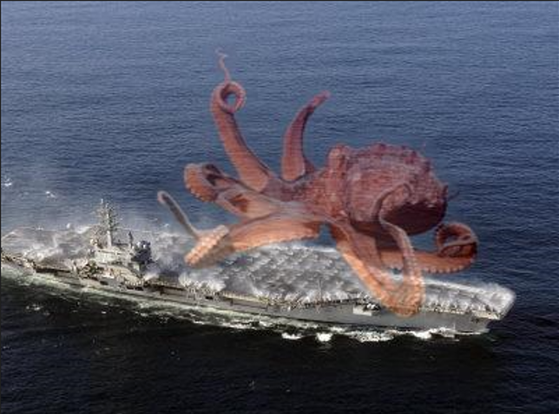
Test_04
Naïve (alpha=1)
Mixing (Alpha= .5)

Slide 6
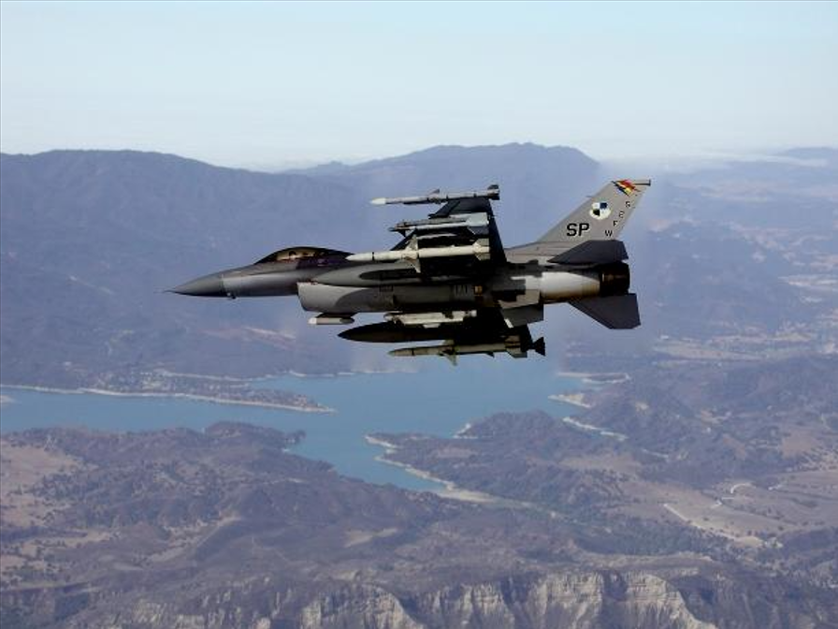
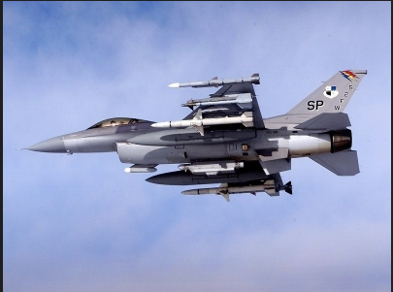
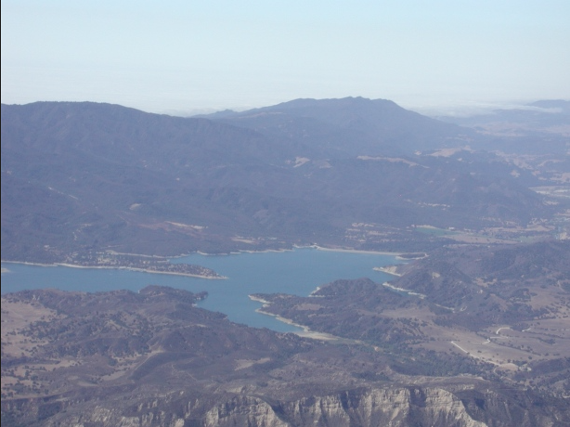
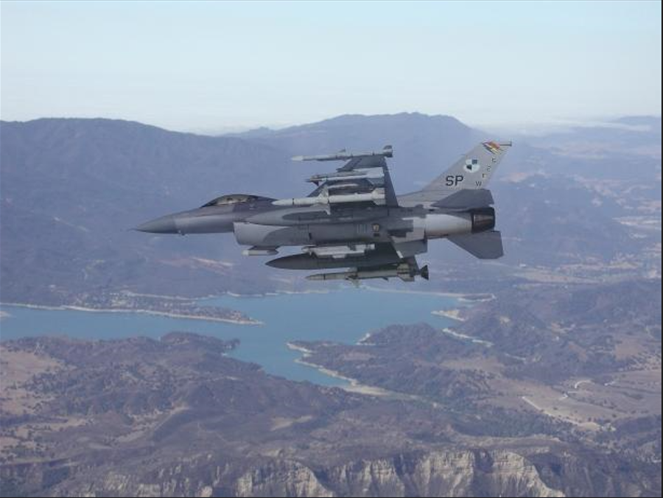
Test_05
Naïve (alpha=1)
Mixing (Alpha= .5)

Slide 7
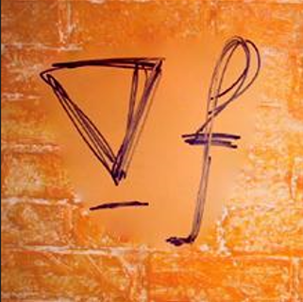
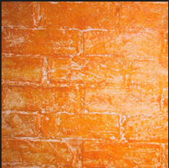
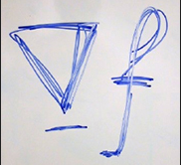
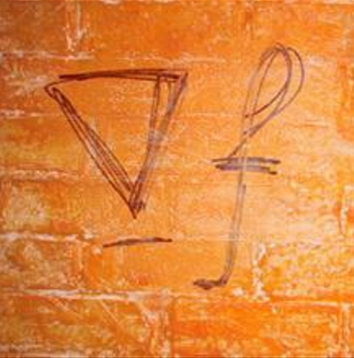
Test_06
Naïve (alpha=1)
Mixing (Alpha= .5)

Slide 8
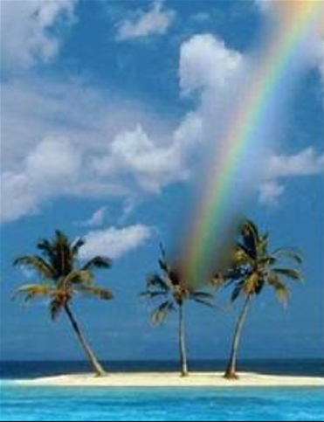
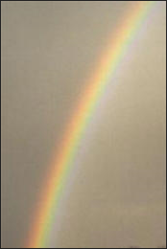

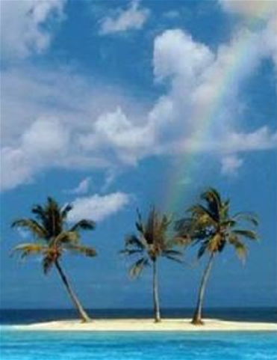
Test_07
Naïve (alpha=1)
Mixing (Alpha= .5)

Slide 9
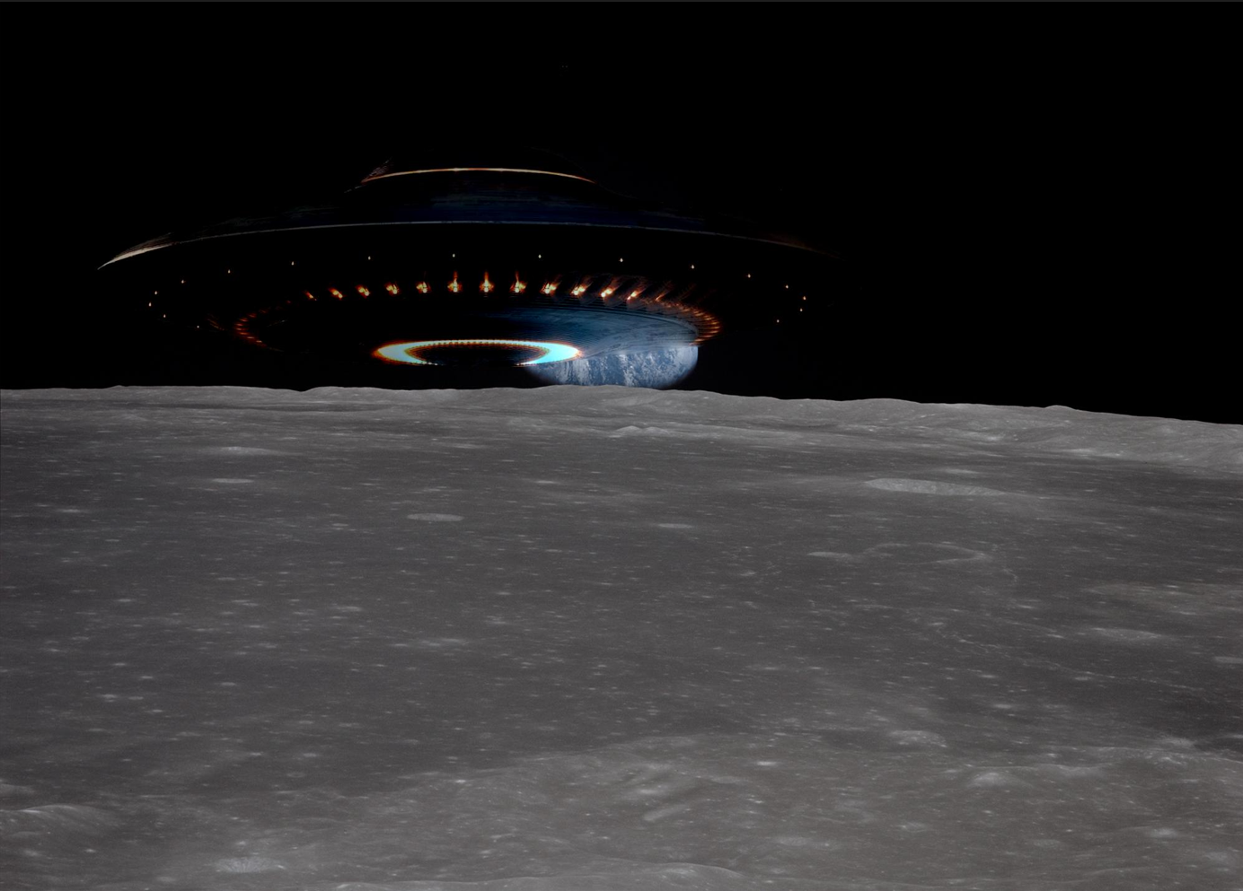
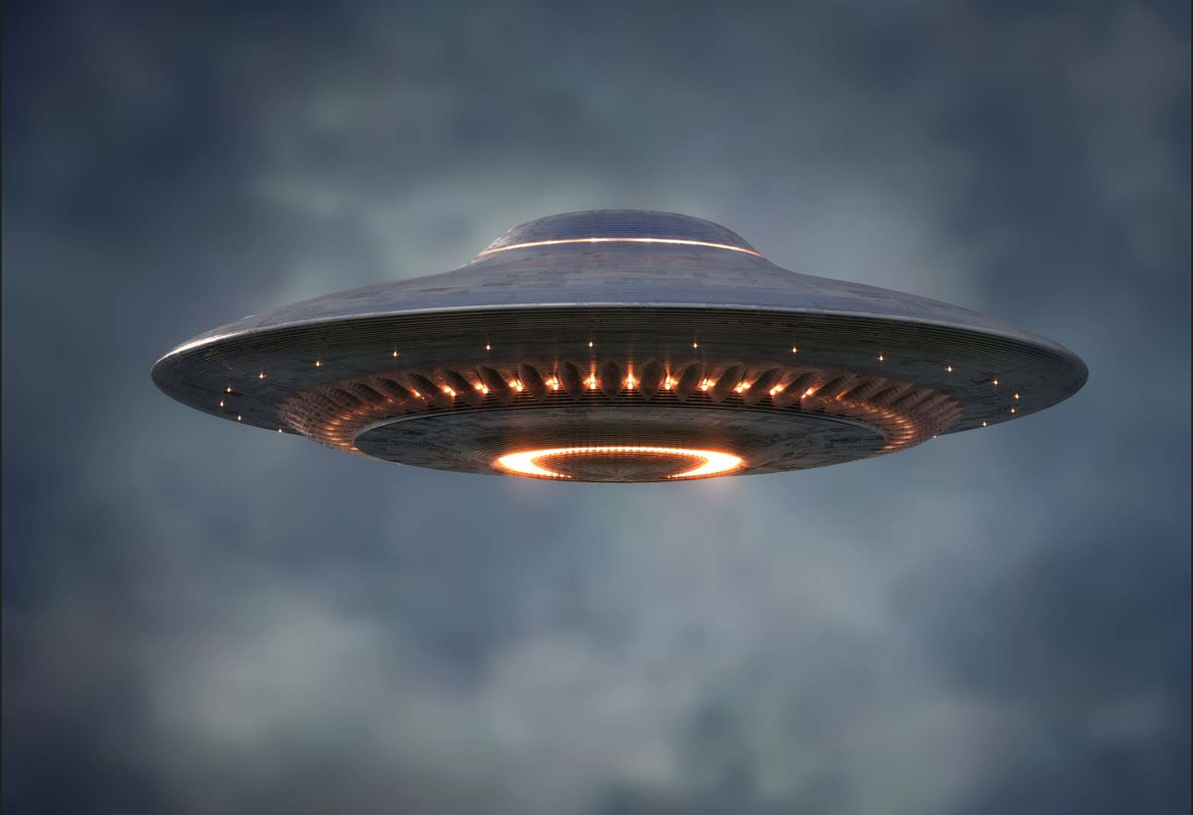
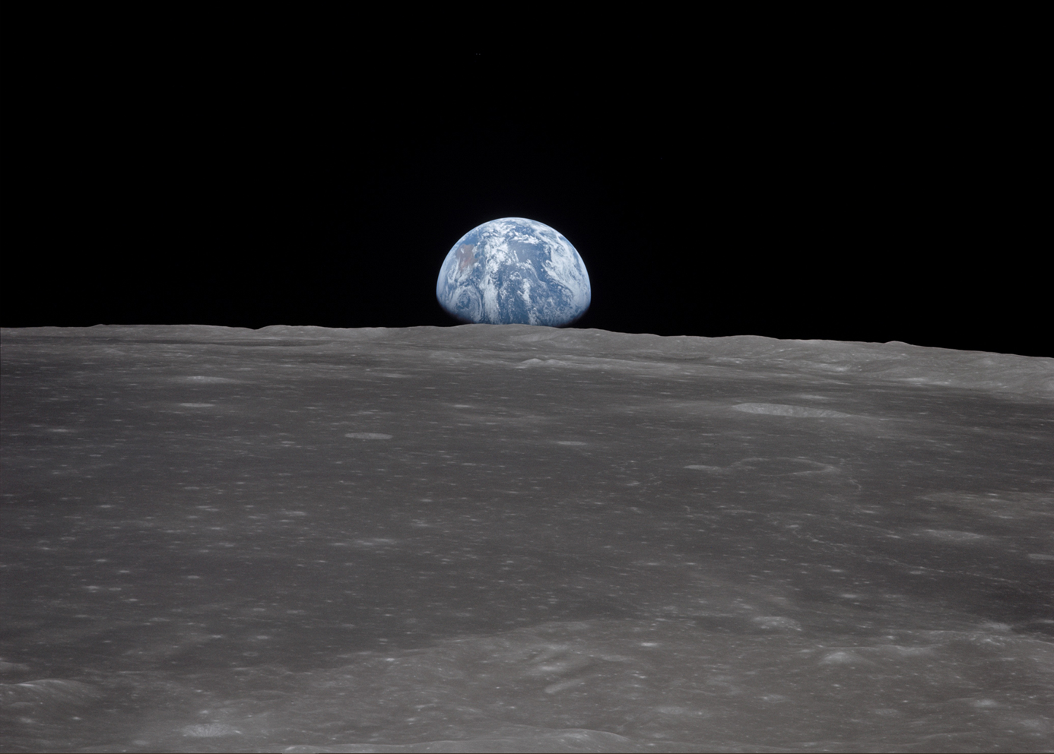
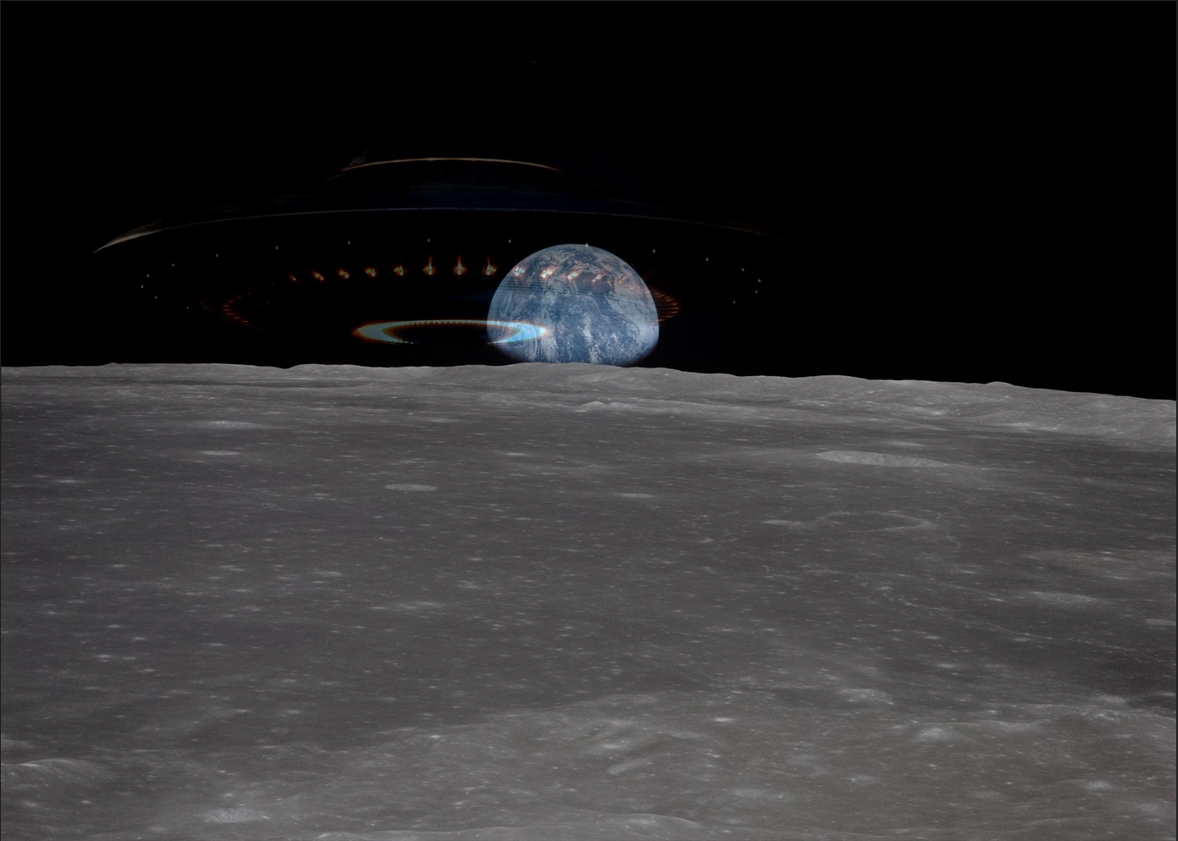
My Example
Naïve (alpha=1)
Mixing (Alpha= .5)

Slide 10
Discussion
Implementation:
This will be a brief dive into the implementation, as the code should contain most details. In order to perform the Poisson Blend, several steps had to be followed. These are, in order:
Pre-Processing, padding to ensure the boundary condition could be processed.
2. Generating the Sparse Matrices.
2a. In the matrixParameters function, the row indices, column indices, A values and B values are generated. This is then used to create the sparse matrice. This was done separately because it was a long section.
3. Solving the system of equations using spsolve.
4. Post-processing. This includes clipping and resizing the image to get rid of padding.
Results:
In many cases, either the alpha of 1 or .5 sufficed for merging these images. In my example, the alpha of 1 showed up quite nicely and even gives the appearance of a reflection off of the UFO. In test 7 and 6 we see cases where the background information needs to be preserved, so these look better with an alpha of .5

